Slide 1
Building Better Title and Typical Section Sheets (Addressing Common Comments)
Jordan A Woodard, P.E., Deputy State Roadway Design Engineer
June 2021

Slide 2
Today’s Agenda
Introduction
Common Comments and How to Address Them
Questions
How to contact and ask questions

Slide 3
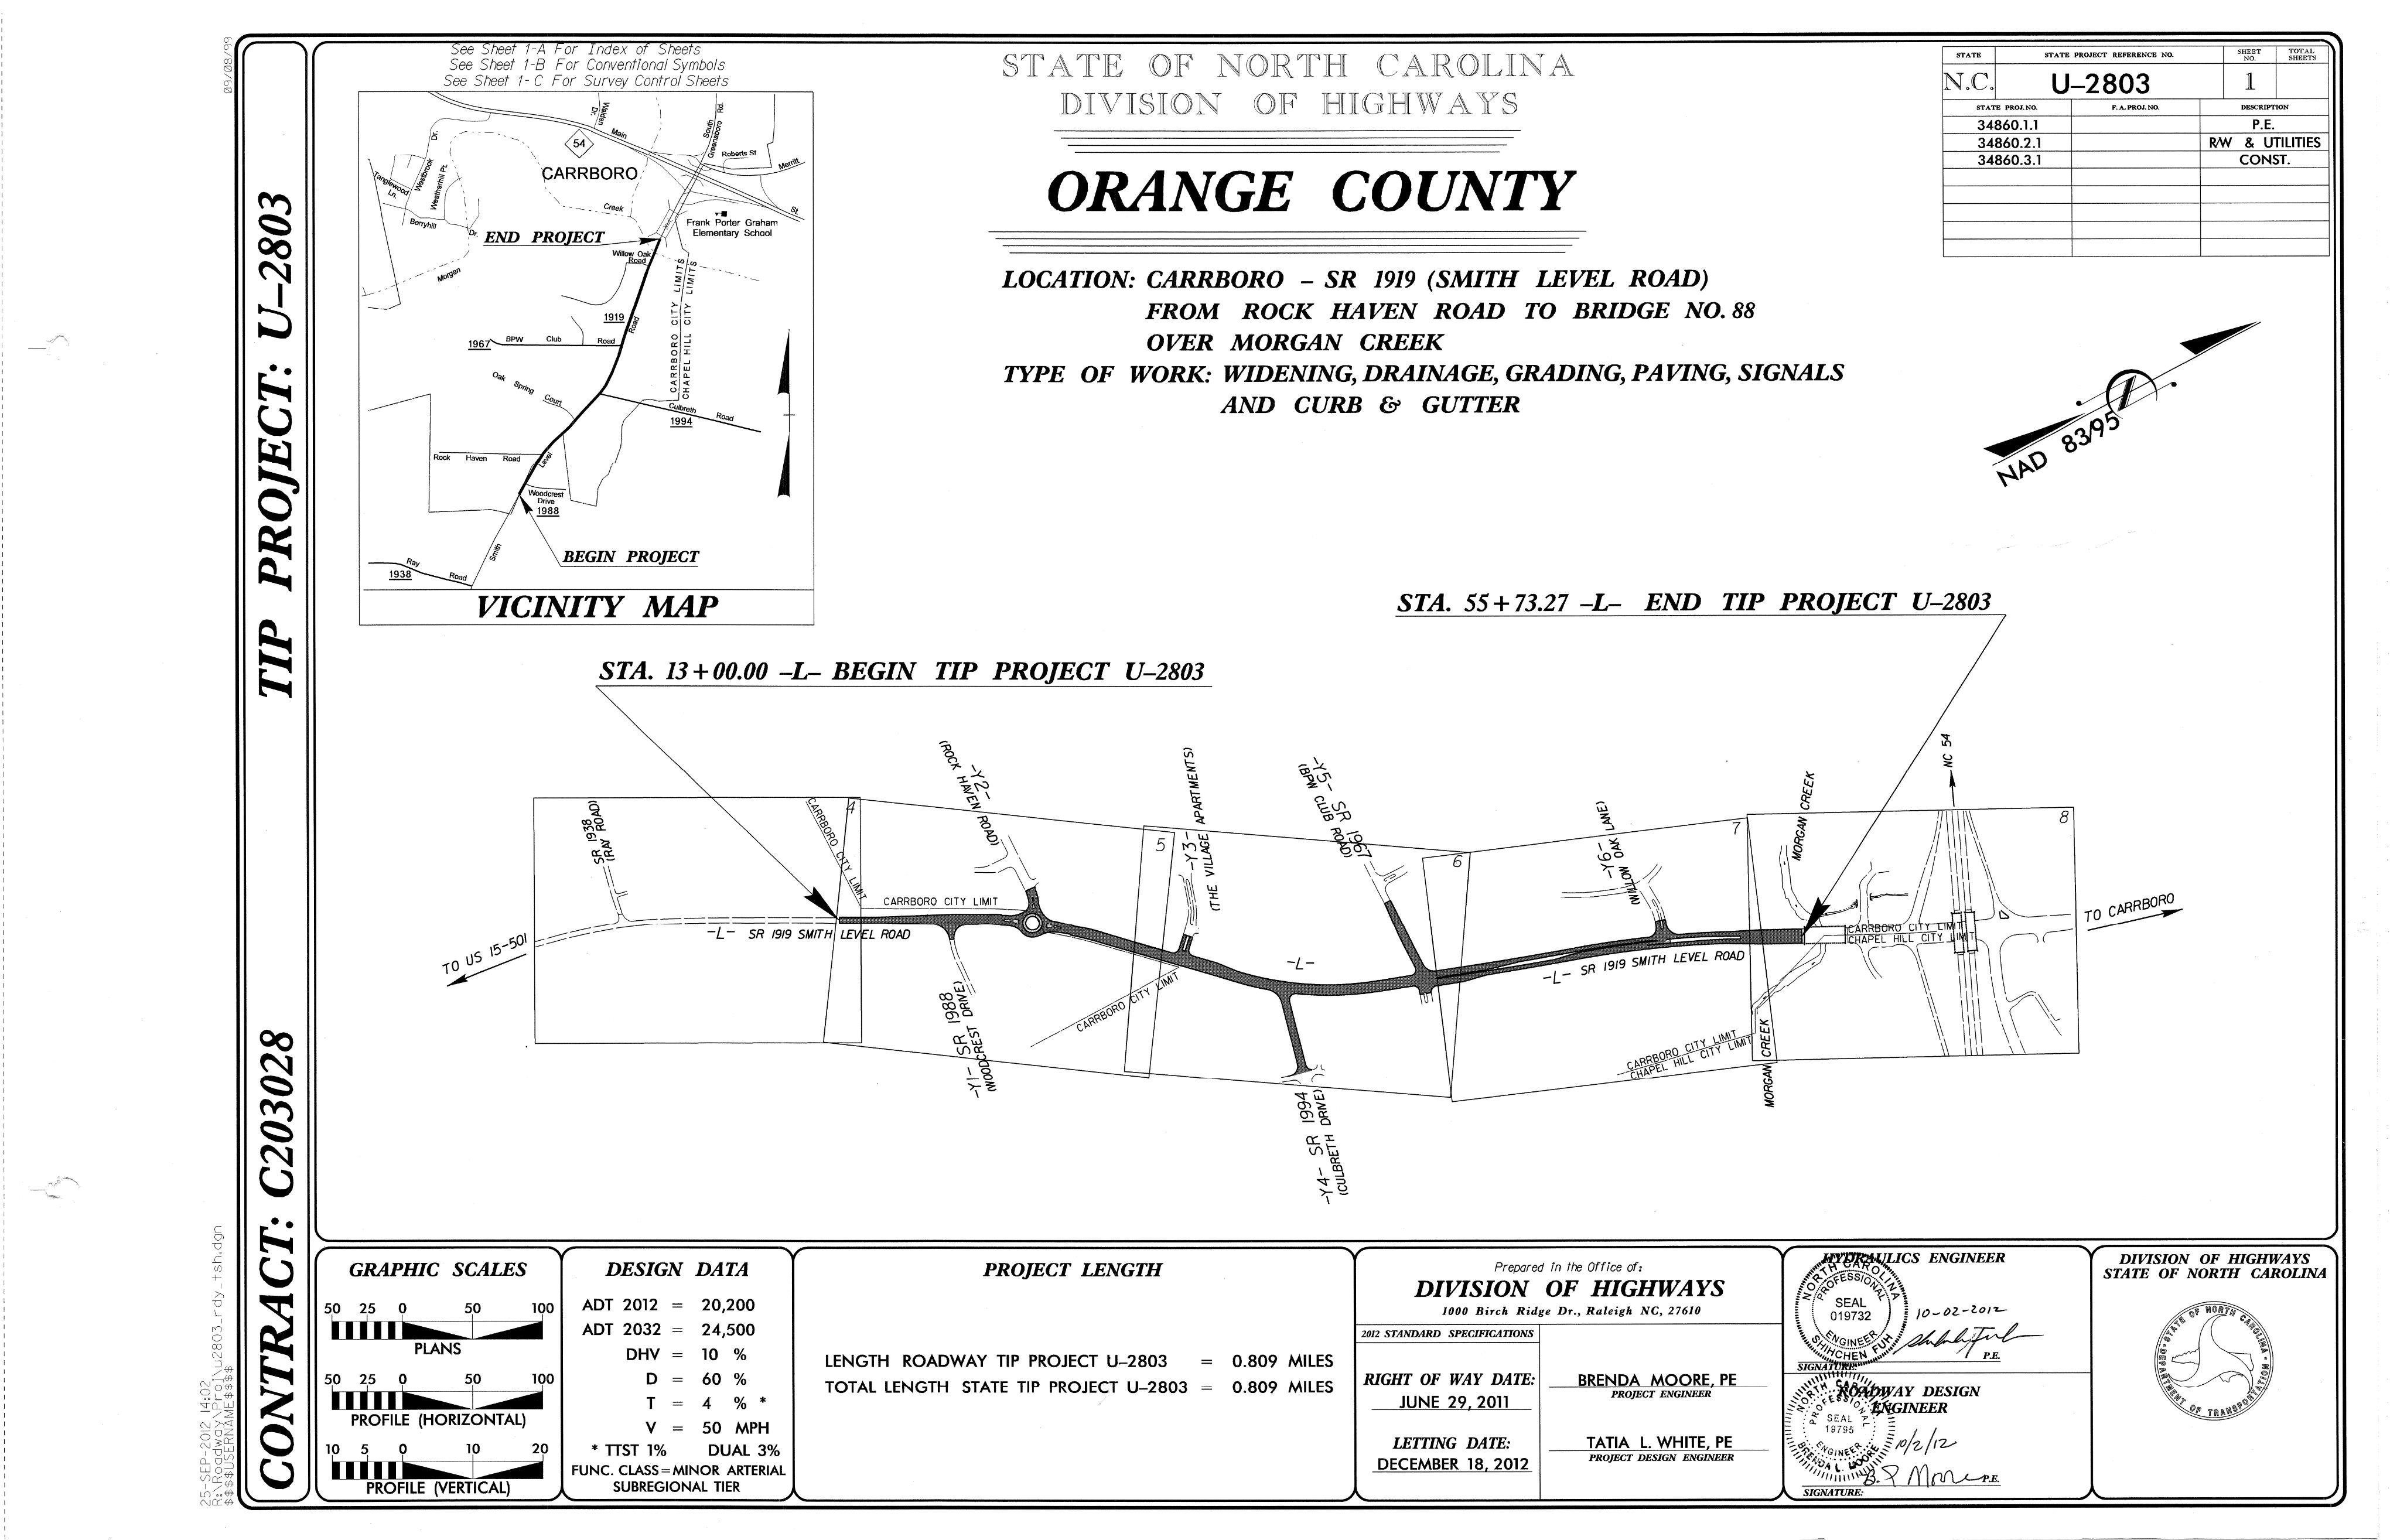
Title Sheets

Slide 4
Type of Work and Location do not match Let List
Access the current 12 Month Let List Online
https://connect.ncdot.gov/letting/Pages/12month.aspx
If you have any changes that need to be made to the location or type of work, contact your project manager.

Slide 5
WBS and FA Numbers, according to SAP, are out of date
DOT Internal: The latest WBS/FA Numbers can be obtained through SAP
Operation Code: ZPSR25
DOT External: Please contact your project manager for the latest WBS/FA Information.

Slide 6
Stationing Information from Project Does Not Match Plans
Tip: Create a Project Spreadsheet to verify and confirm stationing matches on Titles/Typicals/Plans/Profiles for:
Begin/End TIP
Begin/End Construction
Begin/End Bridges
Culvert Locations

Slide 7
Text of North Arrow should match the datum description on survey control sheet(s)
Check Project Survey Report
Word Document
Located in Location and Survey Folders on Project Store or ProjectWise.

Slide 8
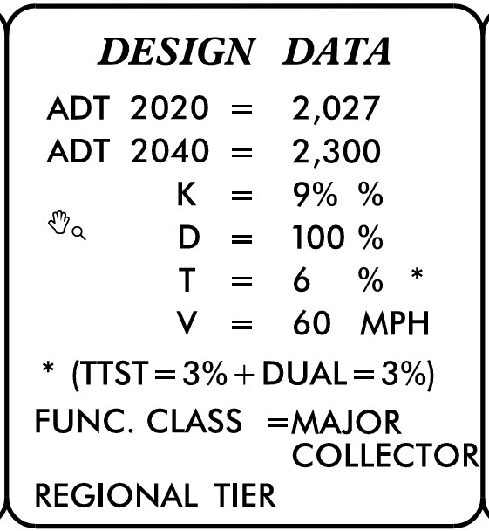
Design Data Errors
Traffic Data
Road Classification
https://connect.ncdot.gov/projects/planning/Pages/Functional-Classification-of-Highways.aspx

Slide 9
Design Year Traffic is Calculated Incorrectly
Traffic Data Beyond Traffic Forecast?
Have Traditionally interpolated linearly
This process is currently under review
Further Guidance on Design Data
RDM Part 1 Section 1-1C
Notes:
Bring up the complete streets policy

Slide 10
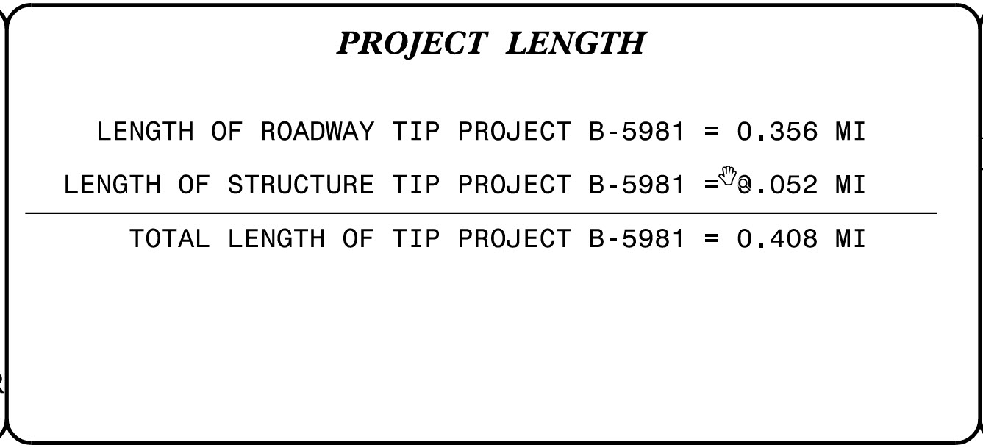
Project Length is Incorrect
Further Information
RDM Part 1 Section 3-1I

Slide 11
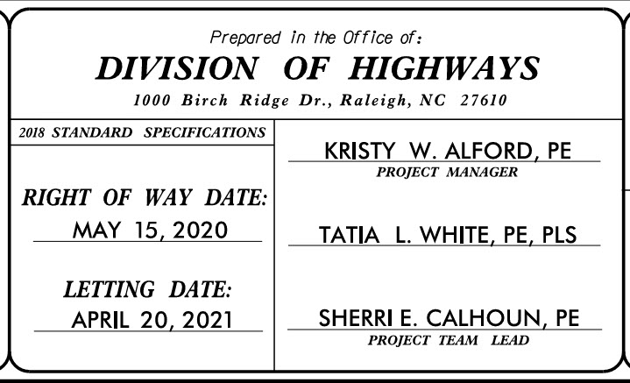
Design Contact Information is Incorrect
Verify the NCDOT Project Manager is identified correctly

Slide 12
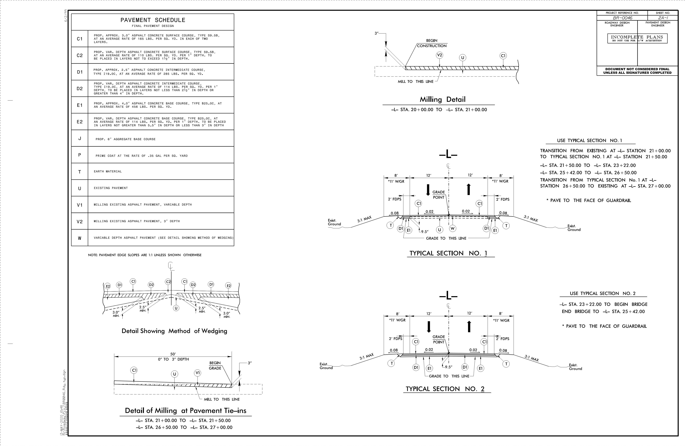
Typical Section Sheets

Slide 13
Stabilization is not shown correctly in the typical section or pavement schedule
Make sure to show on typicals and include in areas specified by the Geotechnical Recommendations.

Slide 14
Trench or Graded Shoulders Sections?
Pavement Depths <= 10”
Should be shown as a “trench” section
Pavement Depths > 10”
Should be shown as a “graded” section
Shelf Behind C&G
Errors made on when to show shelf and how much
RDM Part 1, Section 1-3E

Slide 15
Prime Coat (P) is not shown or shown incorrectly
Information on when Prime Coat is used:
RDM Pt. 1 Ch. 11, RDM Pt. 2 Ch. 6.
Driveway memo pavement design.

Slide 16
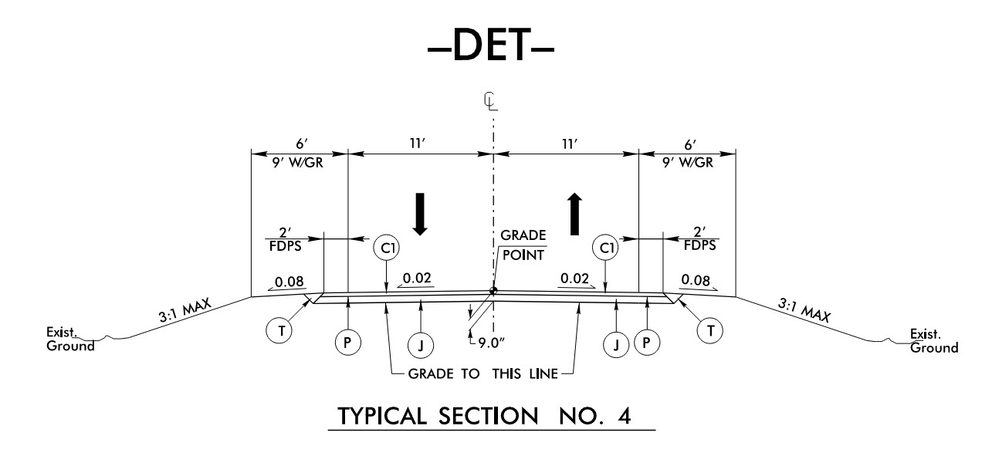
Temporary Pavement Locations and Designs
Hint: Make sure you review your traffic management plans for any temporary pavement locations.
Notes:
Questions:
Chapter 1: What should I be documenting on a design that is flexible?
-Why the proposed design is the best solution
-How it meets the needs of the project
-How it fits in to the limitations of the projects (constraints or funding)
-Overall, the factors driving the decision
Chapter 3
Can I use the 85 MPH design speeds in my current designs
No, not at this time. We are not designing for this speed currently
Chapter 4
How can I use the guidance on median geometry in Chapter 4?
Please see page 4-42.
I table is provided to help with determining median needs
Chapter 5
When will this new information for local roads be included in the RDM?
The RDM is currently being updated with a planned release date of late next year 2020.

Slide 17
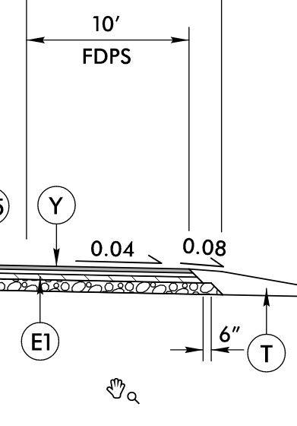
Rumble strips are not shown in the typical section or pavement schedule
RDM Part 1 Section 1-4P

Slide 18
Pavement Schedule Incorrect/unclear
Pavement Schedule Guidance
RDM Part 2 Section 6-1D
Correct Application Rates for Pavement
RDM Part 2 Section 6-1D
Correct Lift Depths (Pavement Design)
Hint: Review in comparison with Pavement Design

Slide 19
Typical Section Dimensioning/Labeling Issues
Make sure the “Math works” on Dimensions
Be Consistent in Labeling
Ex. 6’-0” or 6’
Label enough information for the typical to be buildable but refrain from dimensioning “clutter.”
Ensure Typical Section Dimensions Match Approved Design Criteria

Slide 20
Contact the Plan Review and Design Support Team Lead for your project.
You may also reach out to me at jawoodard4@ncdot.gov

